Slide 1
Chapter Four
Responding to Emergencies on the Surface

Slide 2
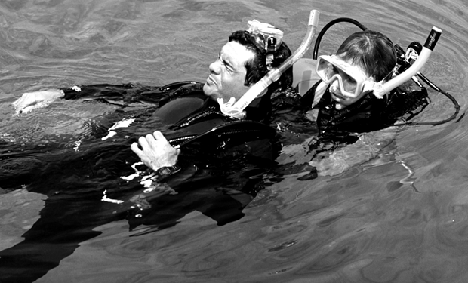
Topics In This Chapter
Emergencies at the Surface
Staying Alert to Trouble
Reach or Throw
Swimming Rescues
Tired Diver Assist
Conscious Diver on the Surface
Unconscious Diver on the Surface
Rescue Breathing
Rescue Breathing Techniques
Equipment Removal
Removing a Diver from the Water
Recovering a Person to a Boat

Slide 3
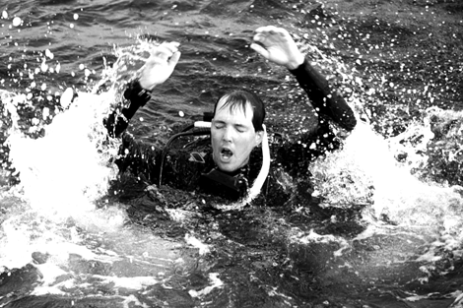
Emergencies at the Surface
Ultimately all diving rescues and assists
become surface rescues
Most accidents happen at or near the surface (even if the situation began to develop underwater)
In any underwater emergency, most often the principal goal is to get the victim to the surface as quickly as possible

Slide 4
Staying Alert to Trouble
Keep eyes and ears open, for signs of a
diver in distress
Listen for a whistle or shout in the distance
Watch for a diver alone on the surface – could suggest that buddies are separated, or that one surfaced in haste
Watch for a diver in an unlikely area, such as a surf zone or ship channel
Watch a diver’s bubbles – alternately swimming and surfacing may be experiencing buoyancy or equalization problems
Watch for a diver at the surface who is very high in the water, or very low in the water

Slide 5
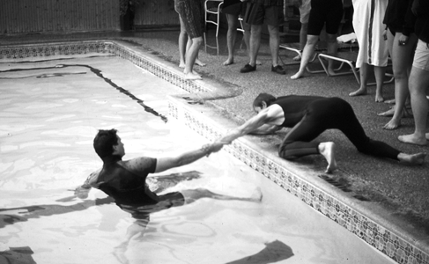
Reach or Throw
Remember that your own safety comes first
Reach out with an arm, keeping low and well balanced
Use another object to extend reach – oar, boat hook
Throw something to the victim – life ring, throw bag, floatation device
Then simply pull the victim back to shore or the boat

Slide 6
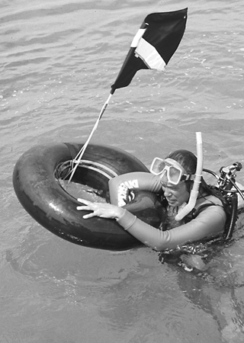
Reach or Throw
Reaching or throwing is preferred
Eliminates the need for a rescuer to enter the water
Provides the quickest response

Slide 7
Swimming Rescues
Don’t allow yourself to become another
victim
Be certain of your ability to swim the distance and then tow the person back
If possible, take a floatation device – it provides additional support, and keeps the victim at arm’s length
Approach with a heads-up front crawl, keeping victim in view
Stop out-of-reach and observe behavior of victim

Slide 8
Swimming Rescues
If the victim seems under control . . .
Extend the floatation device
Have the victim roll onto his back
Have the victim breathe deeply
Continue to talk to the victim during tow

Slide 9
Swimming Rescues
Panicky diver at surface
A panicked diver loses control, and is unable to care for himself
Victim requires immediate assistance – risk of exhaustion and drowning
Stop out-of-reach and try to communicate
Instruct victim to inflate his own BC

Slide 10
Swimming Rescues
Panicky diver at surface
If you must assist . . .
Add air to your own BC
Carefully circle around behind the victim
Grasp victim’s tank valve
Reach over victim’s shoulder to inflate his BC

Slide 11
Swimming Rescues
If the panicked diver attempts to climb on
top of you . . .
Evade: swim away backwards, and use your foot to push him away
Control: reach across to his opposite hand, and quickly pull / turn victim
Escape: submerge while pushing victim up and away

Slide 12
Tired Diver Assist
The most likely rescue you’ll ever perform
is a tired diver assist
Plan your dive so that you have enough reserve energy in case of a difficult swim back to shore
Watch for buddy lagging behind during surface swim
Calmly communicate with diver, during assessment and assist
Check for associated problems – cramps,
overweighting, buoyancy issues, or cold
Get diver onto his back, breathing deeply
Tow, grasping the diver’s tank valve
After a few minutes of rest, victim may be able to assist with finning

Slide 13
Conscious Diver on the Surface
Assess circumstances while approaching
the distressed diver
Does he respond to questions?
Can he tell you what’s wrong?
Does his equipment appear to be intact?
Has his mask been discarded?
Is he in danger of inhaling water?
Is his breathing pattern abnormal?
Is he coughing or choking?
Is there any bleeding from his mouth or nose?

Slide 14
Conscious Diver on the Surface
Start signaling for help . . .
When there are indications of more than just a tired or cold diver
When assistance will be needed for a long or difficult tow
When assistance will be needed to remove victim from the water

Slide 15
Unconscious Diver on the Surface
An unconscious, breathing diver is
in extreme danger
Inhalation of water
Drowning

Slide 16
Unconscious Diver on the Surface
Unconsciousness can stem from . . .
Drowning
Barotrauma
Hypothermia
Contaminated air
Exhaustion
Panic-related breathing irregularities
Marine life injury
Traumatic injury

Slide 17
Unconscious Diver on the Surface
Attempt to get a response from victim
Shouting to victim
Splashing water at victim
Touching / tapping victim

Slide 18
Unconscious Diver on the Surface
For a face-down victim, approached from
the side
Grab BC and attempt to roll the victim
May need to push / pull him with several fin strokes, to get the victim’s submerged legs elevated enough to allow him to be rolled

Slide 19
Unconscious Diver on the Surface
For a face-down victim, approached from
the head
Reach out, crossing your arms
Use your right hand to grasp victim’s right hand, and your left to grasp victim’s left
Pulling victim’s hands will cause him to roll

Slide 20
Rescue Breathing
Immediately assess the unconscious diver
for breathing
Get the victim buoyant, and positioned on his back in the water
Look, listen, and feel for breathing
Victim’s skin color also may be a good indication of respiration
Presumably an unconscious diver, face-down on the surface without a snorkel or regulator in his mouth, is not breathing

Slide 21
Rescue Breathing
Goal: to ventilate the victim’s lungs
Rescuer’s exhaled breath contains sufficient oxygen
Distribution of oxygen, throughout victim’s body, requires a heart beat
Problematic to determine whether victim has a pulse, while in the water, so simply assume that victim’s heart is beating

Slide 22
Rescue Breathing
The earlier the rescue breathing is started,
the more likely a victim will be resuscitated
Pinch the victim’s nose, to prevent escape of air
Seal your mouth around the victim’s mouth
Administer two full breaths
Begin towing, and continue rescue breathing
Appropriate rhythm, while in the water, is two breaths every ten to twelve seconds

Slide 23
Rescue Breathing
Use of barriers
Prevention of disease transmission
Personal preference, to avoid direct contact
Pocket mask works best if rescuer is positioned at top of victim’s head

Slide 24
Rescue Breathing Techniques
Rescue breathing can be performed from
either side of the victim
Right-handed rescuers often prefer to position themselves on the victim’s left side, in order to tow the victim with their left hand and pinch the victim’s nose with their right hand
In doing so, the rescuer also will be able to use his right hand to remove the victim’s gear

Slide 25
Rescue Breathing Techniques
“Do-si-do” technique
Rescuer takes position at victim’s side, near head
With the hand closer to victim’s feet, the rescuer reaches under the victim’s arm and grasps the tank valve or collar of exposure suit
Rescuer’s other hand is used to pinch victim’s nose
During rescue breaths, rescuer should kick up and also roll patient towards him
Rescuer may use hand to cover victim’s nose and mouth between rescue breaths, to exclude water

Slide 26
Rescue Breathing Techniques
Chin-carry technique
Rescuer takes position at top of victim’s head and uses dominant hand to grasp victim’s chin, while cradling victim’s head on rescuer’s shoulder
Rescuer’s other hand is placed in center of victim’s back, to provide lift
During rescue breaths rescuer slides hand up from chin, to pinch nose
Rescuer may use hand to cover victim’s nose and mouth between rescue breaths, to exclude water

Slide 27
Equipment Removal
Will make it easier to tow the victim, and to
perform rescue breathing
Drop victim’s weights, to aid buoyancy
Remove victim’s mask, to assess respiration and to administer rescue breaths
Remove victim’s BC, to minimize drag while towing and to facilitate victim’s removal from water
At the appropriate time, for similar reasons, the rescuer also should discard his own gear

Slide 28
Removing a Diver from the Water
Backpack carry
Rescuer stops tow in water mid-torso deep, takes off fins, and stands next to victim facing exit
Rescuer reaches across victim, using right hand to grasp victim’s right wrist and left hand to grasp victim’s left wrist
Rescuer pulls and rotates victim, while rescuer sinks below surface
Rescuer pulls victim onto rescuer’s back, with victim’s arms across rescuer’s shoulders
Rescuer stands and carries victim out of the water

Slide 29
Removing a Diver from the Water
Two-person carry
Turn victim, on his back, so that his feet are pointed towards exit
Rescuers stand on either side of victim, facing exit
Each rescuer places victim’s arm over rescuer’s shoulder, and then wraps own arm around victim’s back or waist
Each rescuer reaches under victim’s legs with other hand, and grasps the other rescuer’s wrist
Victim is lifted (in a seated position) and carried out of water

Slide 30
Recovering a Person to a Boat
Unconscious person lift
Position victim with back towards boat
Rescuer (on boat) reaches down, placing hands under victim’s arms
Rescuer should use his legs to lift the diver into the boat

Slide 31
Recovering a Person to a Boat
Roll-up net
Attach inboard edge of net to rail or deck, and drape the rest of the net in the water
Position victim on his back, across the net in the water
Rescuers grasp outboard edge of net, and haul net and victim onto the boat
Alternately may use a tarp, blanket, or lengths of rope in place of a net

Slide 32
Recovering a Person to a Boat
Boarding ladder
Position victim face-to-face with rescuer
Victim’s arms are placed around rescuer’s neck, and rescuer reaches under victim’s arms to hold and climb ladder
Victim’s legs also are placed around rescuer’s waist, supported on rescuer’s knees as rescuer climbs ladder

Slide 33
Recovering a Person to a Boat
Spine boards and floatation litters
Secure the victim to the board or litter, prior to lifting
Valuable when head, neck, or back injuries are suspected

Slide 34
Summary
Ultimately all diving rescues and assists
become surface rescues
Stay alert to signs of a diver in distress
Reaching or throwing is preferred
In swimming rescues, stop and access the diver’s behavior
The most likely rescue is a tired diver assist
Exercise caution in approaching a panicky diver
With an unconscious diver, get him buoyant and on his back
Look, listen and feel for respiration
Initiate rescue breathing as quickly as possible

Slide 35
Scuba I.Q. Review

Slide 36
Scuba IQ Review
1
Q
What signs might signal to an observer that a diver on the surface may be in distress?
A
Encountering or observing a diver alone, divers observed in unlikely areas, unusual bubble patterns, a diver at the surface who is either very high or very low in the water

Slide 37
Scuba IQ Review
2
Q
Why is a reaching or throwing response the preferred way of assisting a diver to shore or to the boat?
A
This keeps us from having to enter the water and is actually a speedier response

Slide 38
Scuba IQ Review
3
Q
Why is it prudent to stop at least 5m/ 15 ft. away from a diver whom you think might be having problems?
A
To observe the behavior of the victim and insure they are in control

Slide 39
Scuba IQ Review
4
Q
Why is panic the leading cause of diver accidents?
A
A panicked diver loses self-control and as such is unable to take care of himself

Slide 40
Scuba IQ Review
5
Q
What are the best steps to follow in assisting a panicked or struggling diver?
A
Approach the diver cautiously,
Talking to the diver;
Watch your ownsafety;
Establish the diver’s buoyancy;
Assist to safety

Slide 41
Scuba IQ Review
6
Q
The most likely rescue scenario in aiding a fellow diver is...?
A
A tired diver assist

Slide 42
Scuba IQ Review
7
Q
An unconscious, breathing diver on the surface is in extreme danger of ?
A
Inhalation of water and drowning

Slide 43
Scuba IQ Review
8
Q
How do we determine if a person is breathing?
A
Look, listen, and feel; the victim’s skin color also may be a good indication of respiration

Slide 44
Any Questions ?

